Slide 1
C# Theseus And Minotaur UWP
Sam Miller

Slide 2
Implement Game Features – expected marks
Must Features
12 marks - all 12 features
Should Features
2 marks – Display a list of available levels/mazes
2 marks – Allow a user to select and load a level/maze
2 marks – only update the changed parts of a level/maze
2 marks - Display dialog box if minotaur kills theseus or theseus exits
2 marks – Display window with options if minotaur kills theseus or theseus exits
Could Features
2 marks – calculate and display elapsed time
2 marks – pause a game to stop timer and hide, un pause to restart timer and show
2 marks – Support undo
2 marks – Save and load to file
2 marks – Play relevant sounds
12 total marks from must features
10 total marks from should features
10 total marks from could features
32 total marks from all features

Slide 3
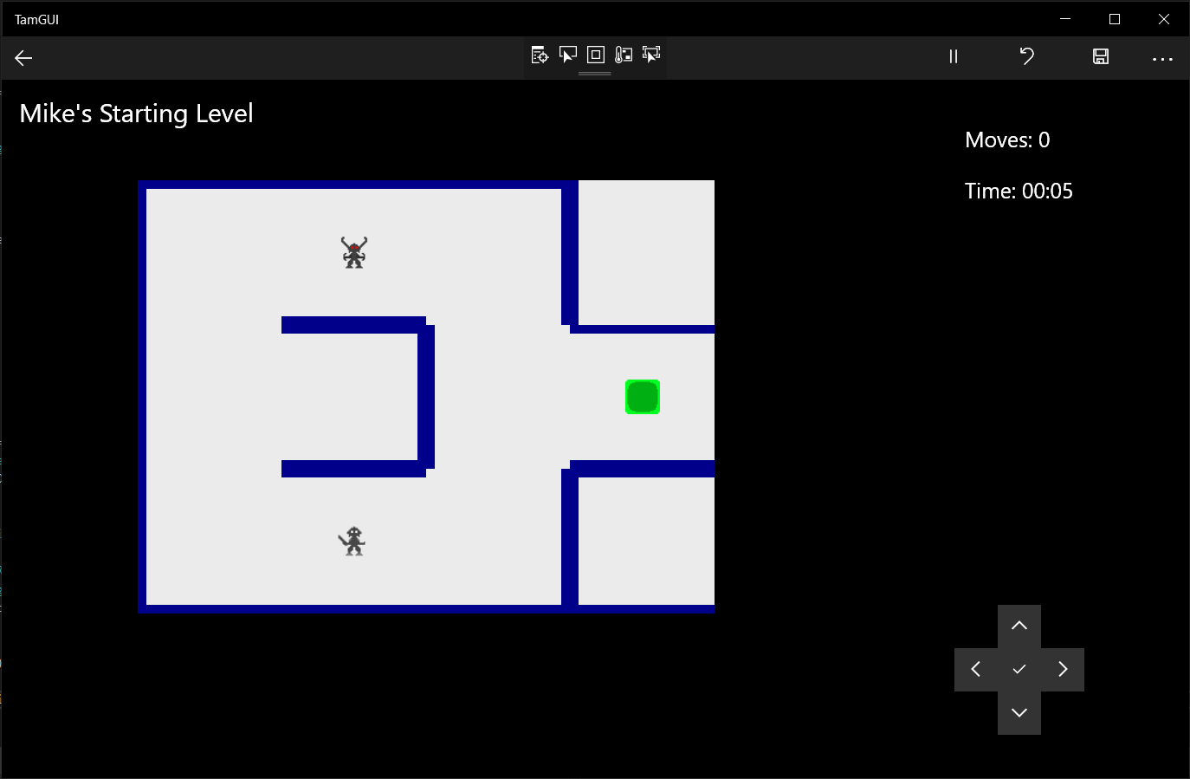
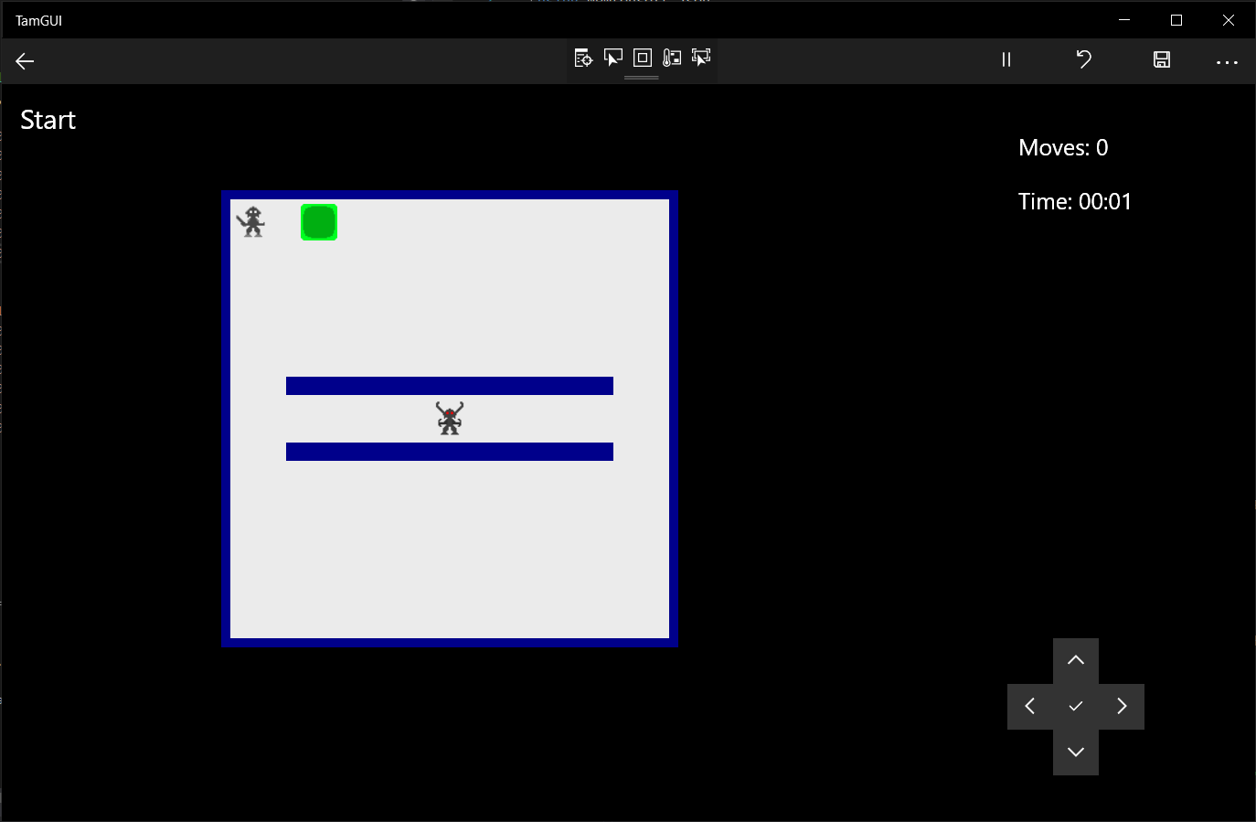
Display the level
Display the starting level/ maze with walls
Display the level/ maze name
Display the image of Theseus
Display the image of Minotaur
Display the image of Exit
Example of all 5 listed features shown.

Slide 4
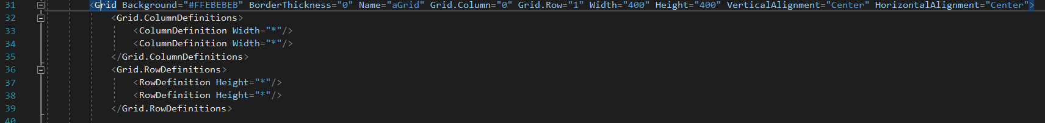
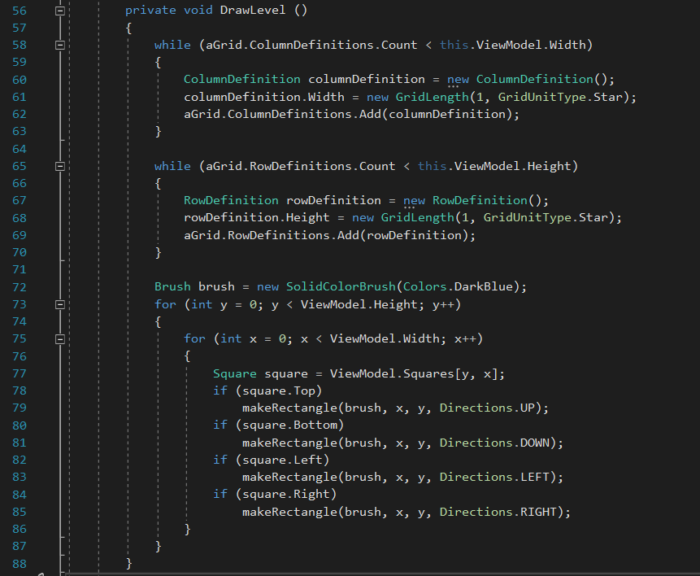
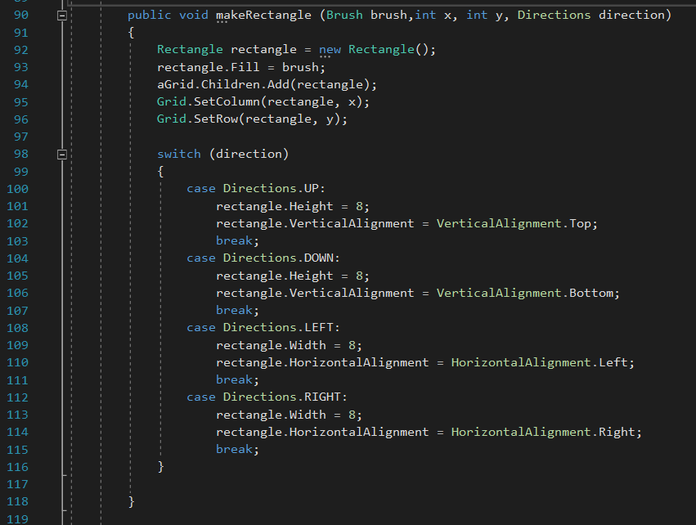
Display the level
Examples of code for displaying the level

Slide 5
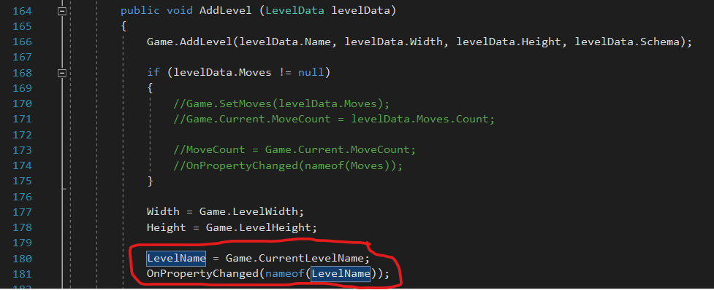
Display Level Name
Code in View and Viewmodel for showing level name

Slide 6
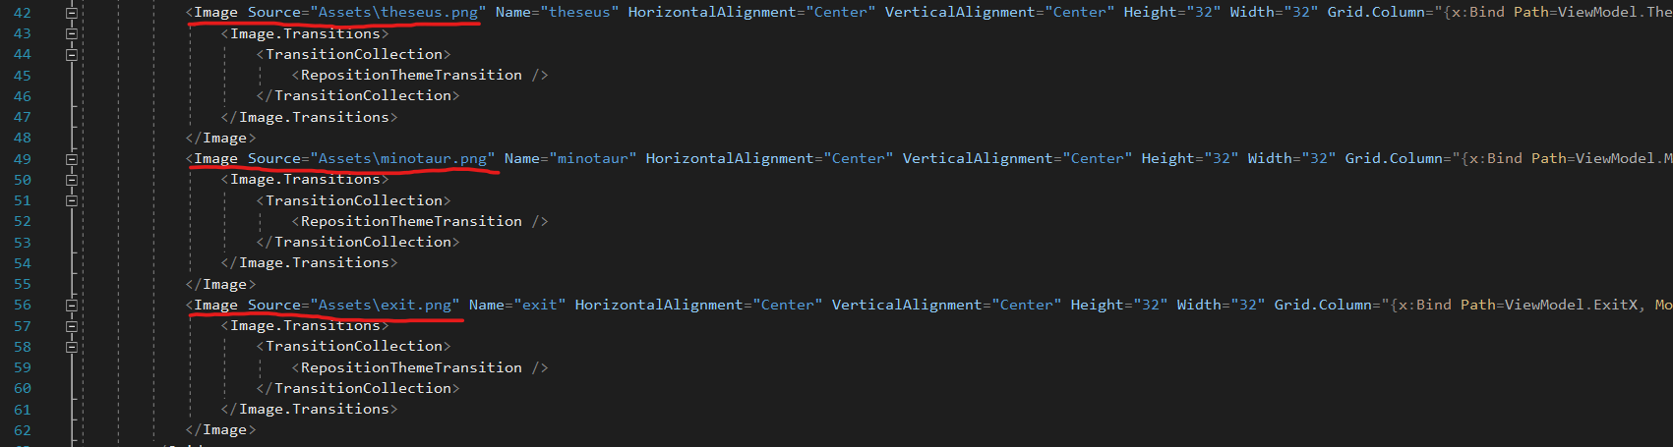
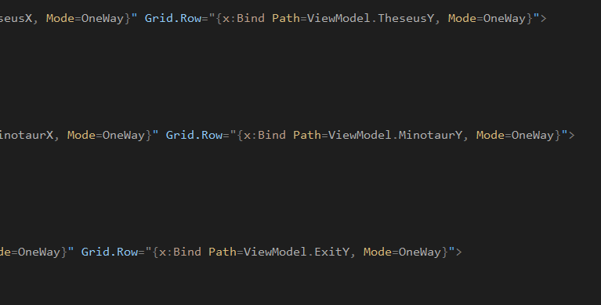
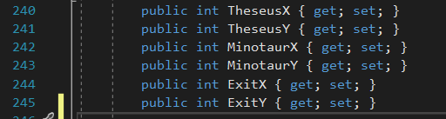
Display images of theseus, minotaur, exit

Slide 7
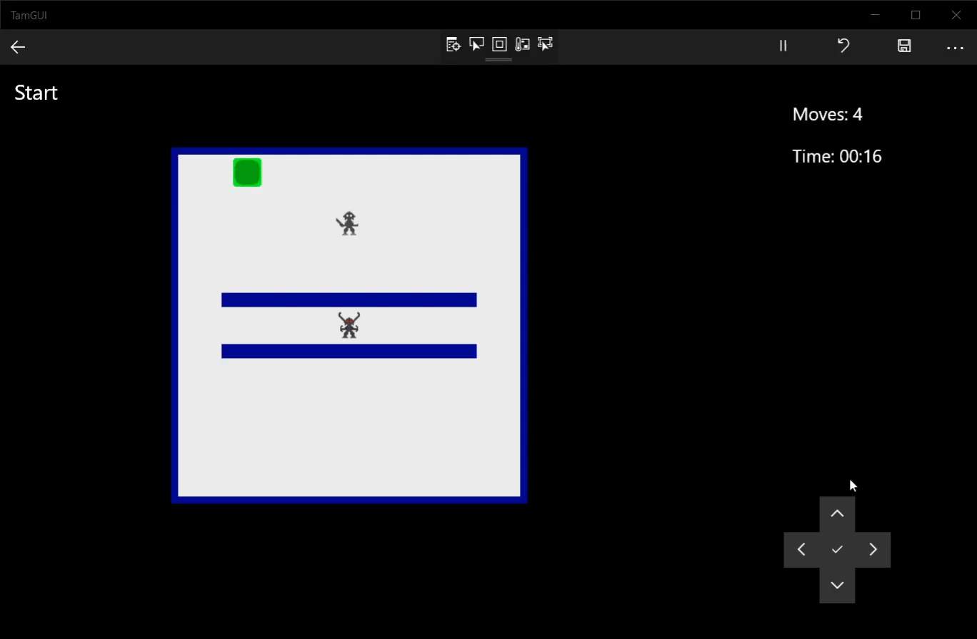
Input Moves (UP, DOWN, LEFT, RIGHT, PAUSE)

Slide 8
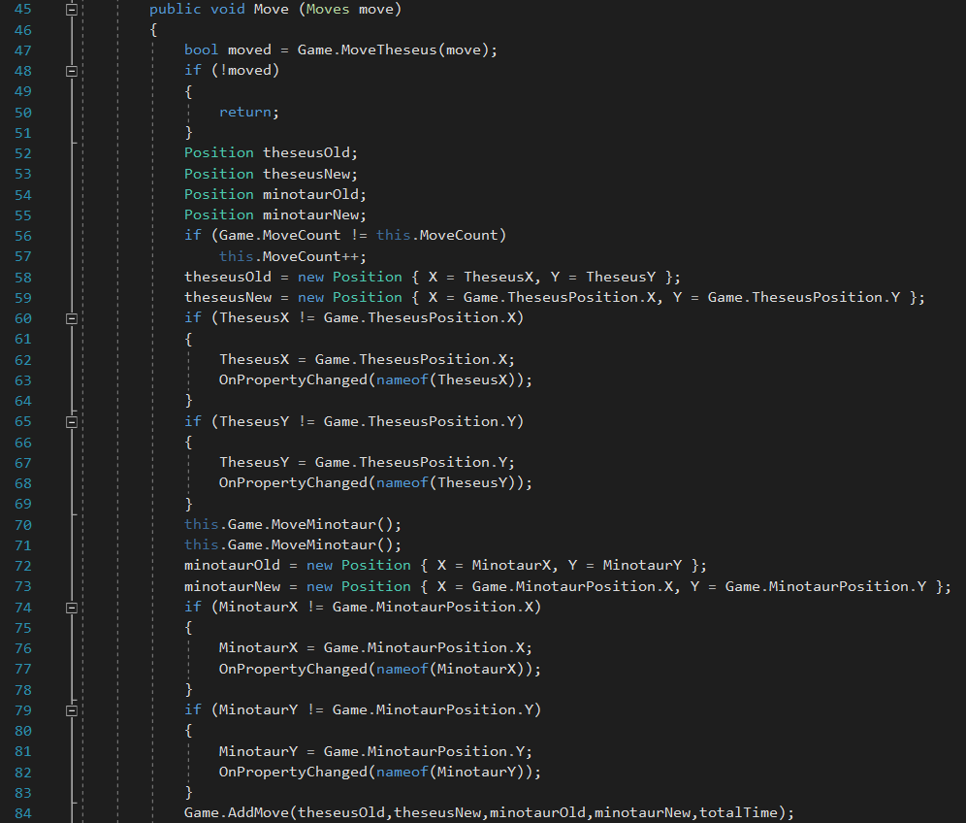
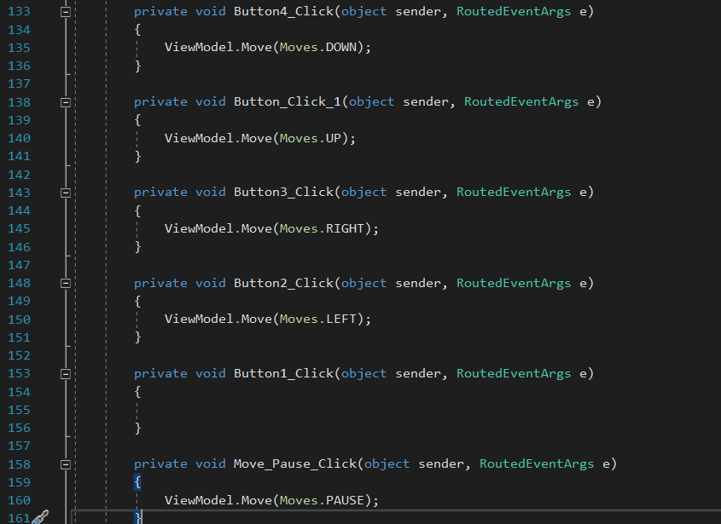
Input Moves (UP, DOWN, LEFT, RIGHT, PAUSE)
Pause Move != Pausing game and hiding the level
All moves are passed to the Game Class on input

Slide 9

Display an updated move count

Slide 10
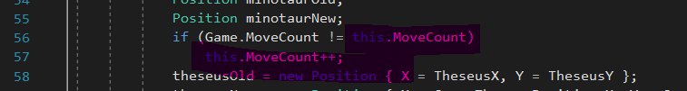
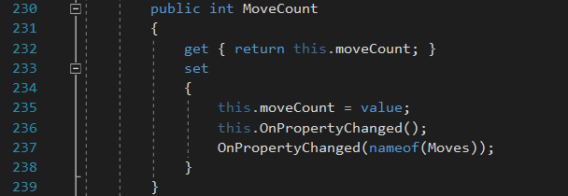

Display an updated move count
Implementation of move count, uses both a property with custom implementation and an auto implemented property

Slide 11
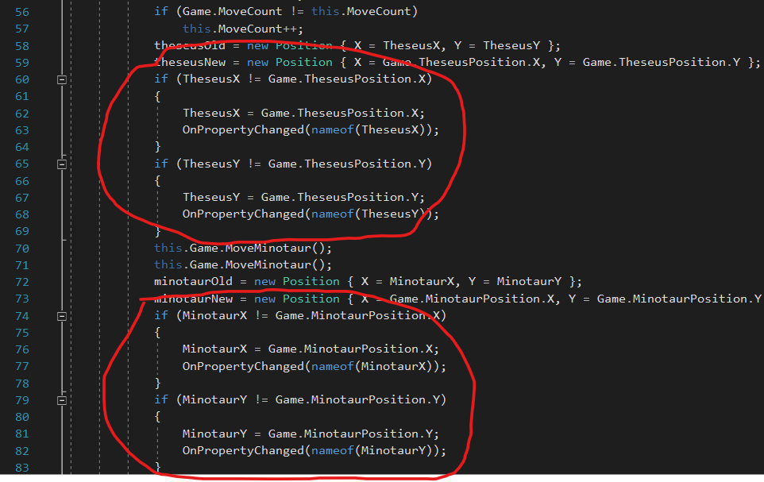
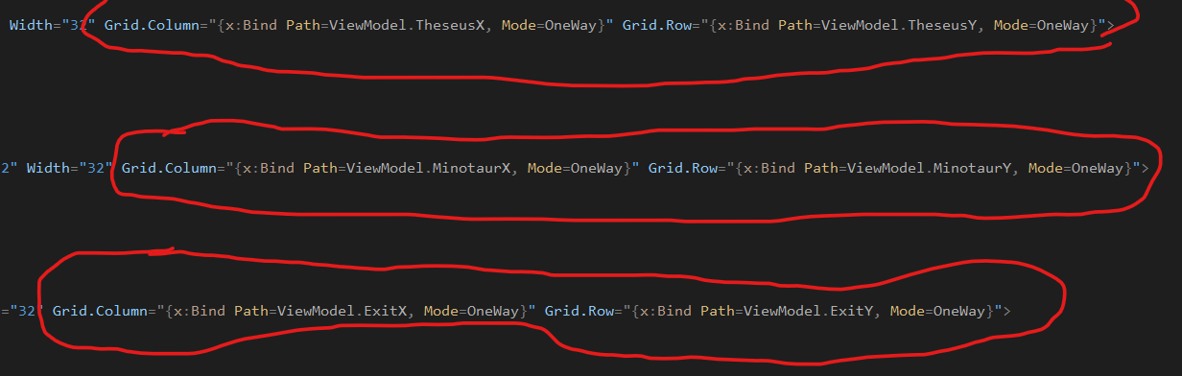
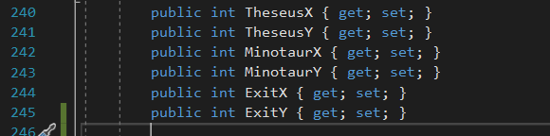
Update the level/maze display correctly after every move
Examples of this behavior in gui under updated move count and movement

Slide 12
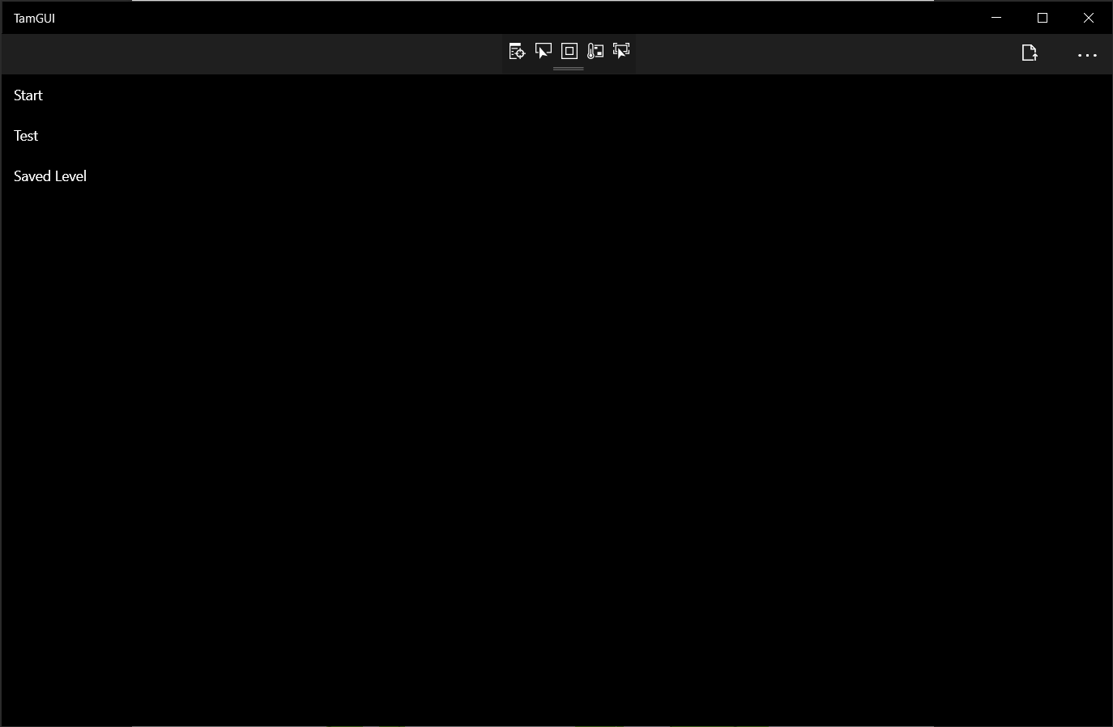
List of mazes/levels
Shows both levels that are in game code and additionally shows the saved level

Slide 13
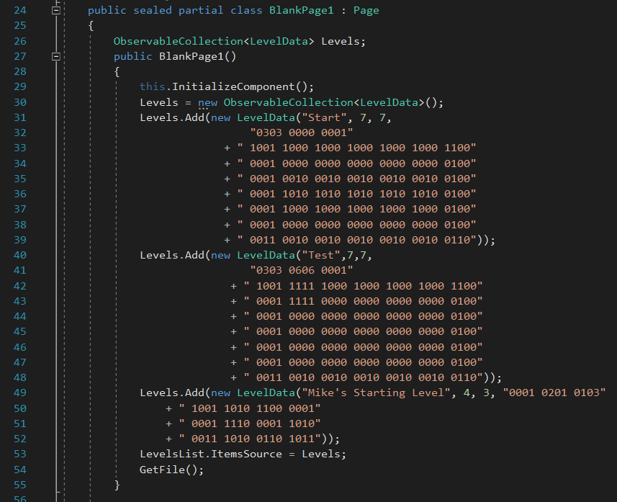
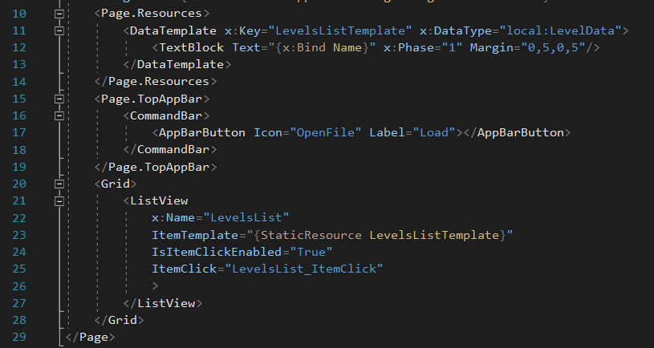
List of mazes/levels

Slide 14
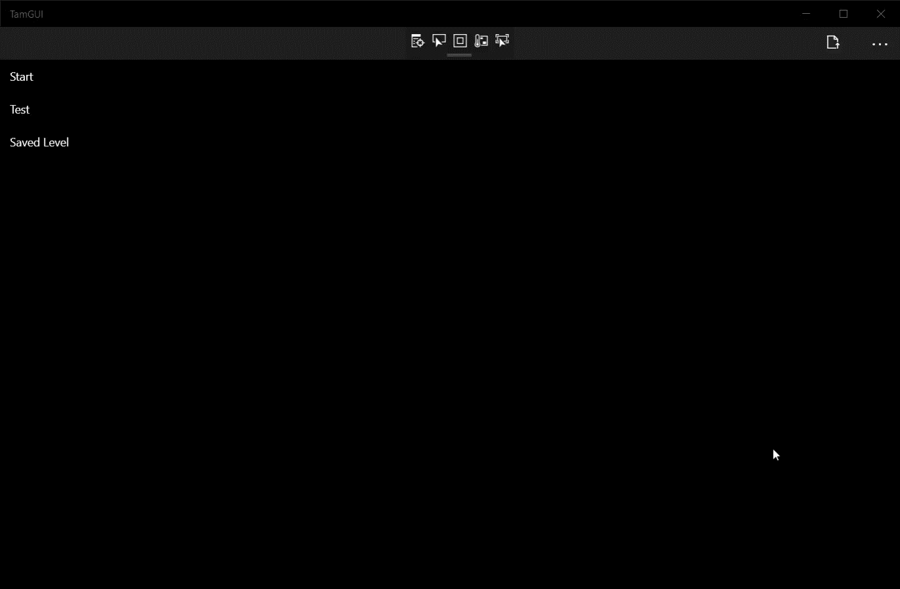
Select and load a Level/Maze

Slide 15
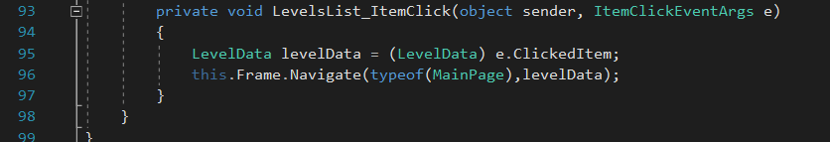
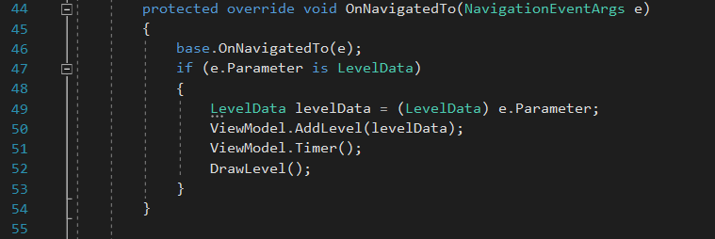
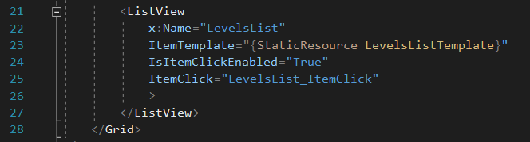
Select and load a Level/Maze
Allows for selection of any maze in the game

Slide 16
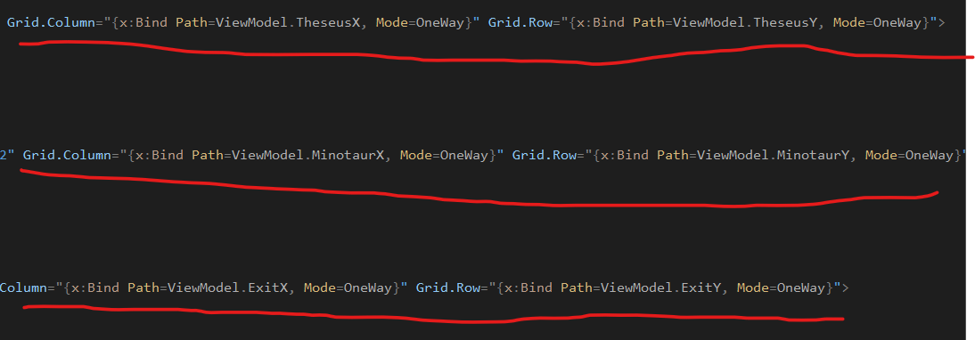
Only update the changed parts of a level/maze
The positions of Theseus, The Minotaur, and The Exit, can be updated without redrawing the level.
Exit doesn’t move but shares logic with Theseus and The Minotaur
Levels are only drawn fully once, which is during loading

Slide 17

Dialog box + Window with options

Slide 18
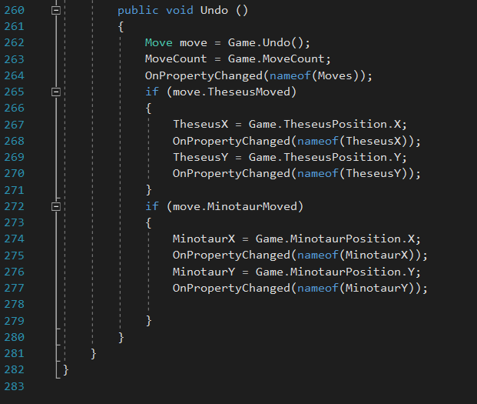
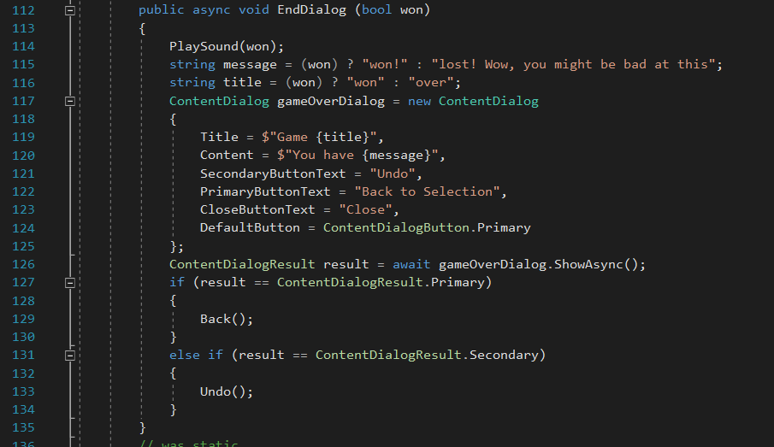
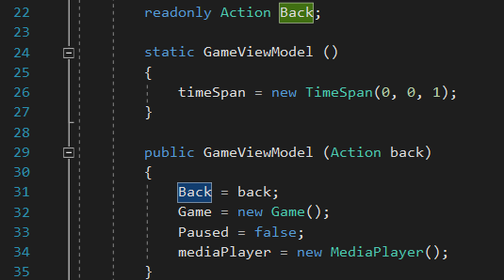
Dialog box + Window with options
Implements both dialog box and window with options features under should have features
Both were combined because they contain similar functionality
Uses uwp dialogs, but also has options

Slide 19
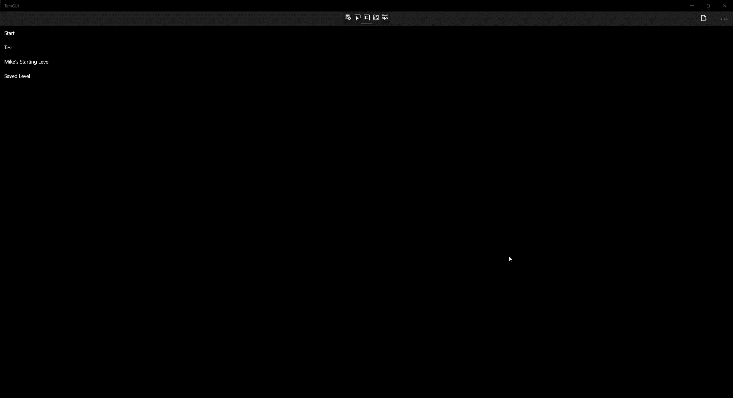
Calculate and display the elapsed time

Slide 20
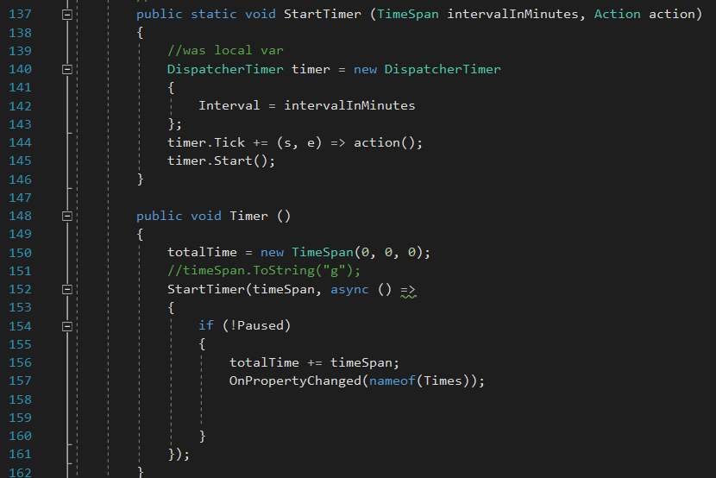
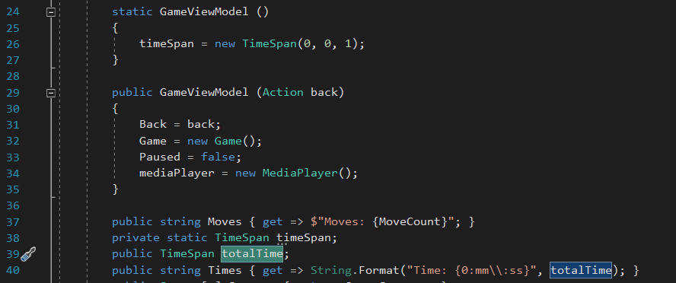
Calculate and display the elapsed time

Slide 21

Pause a Game

Slide 22
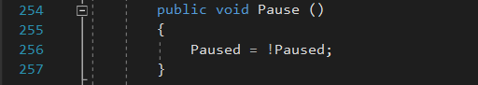
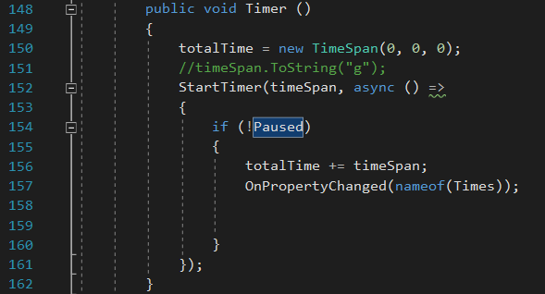
Pause a Game
Hides Level, and Stops timer as per requirements
Not to be confused with the confusingly named move “Pause”

Slide 23
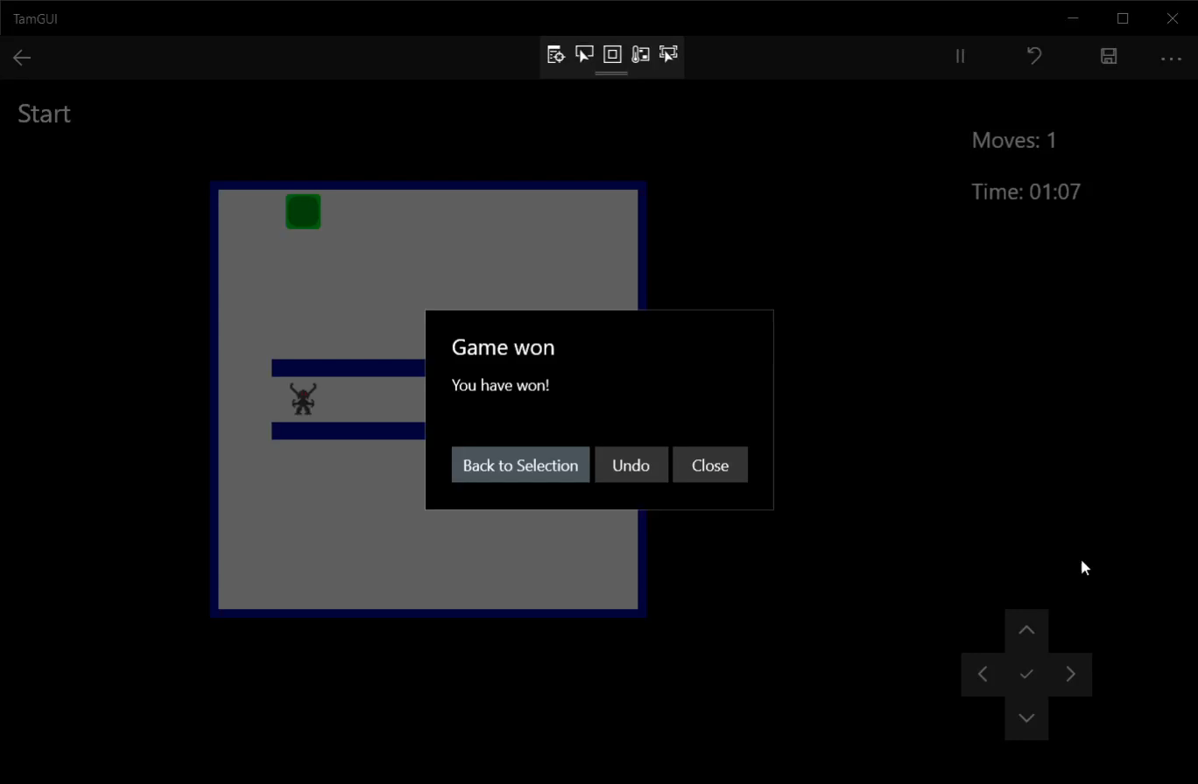
Support Undo

Slide 24
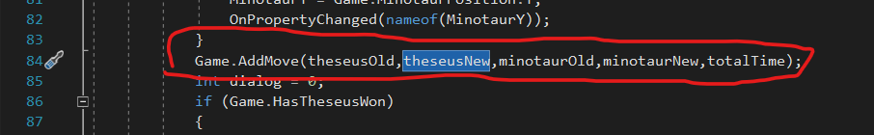
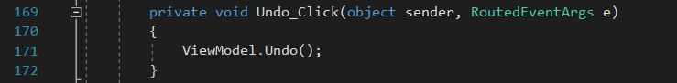
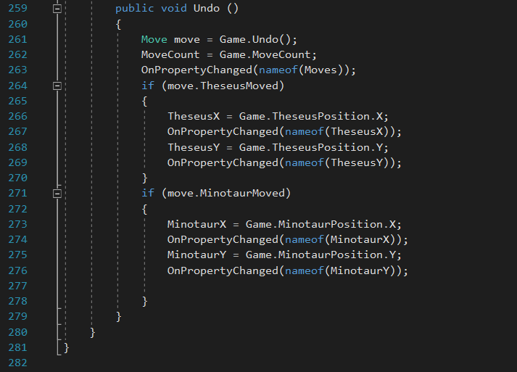
Support Undo
Additionally, changes were made to the model to support this feature

Slide 25
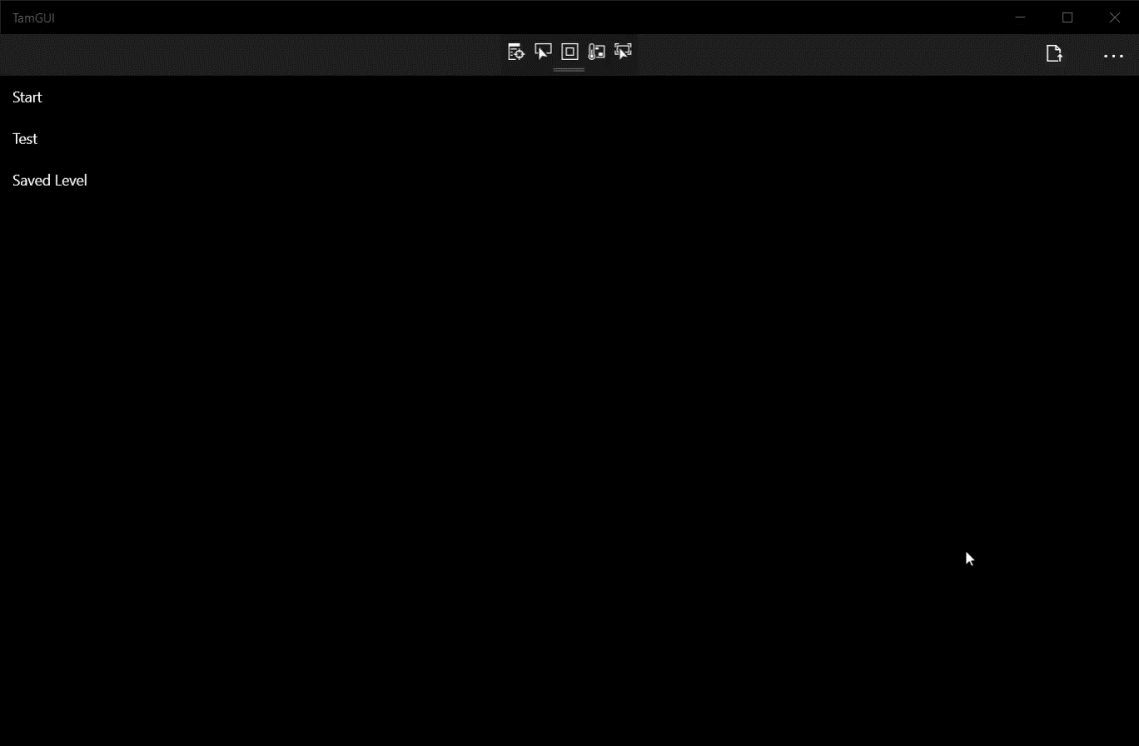
Load and continue to play previous unfinished game by using file storage to save and load a status of the game during playing

Slide 26
Load and continue to play previous unfinished game by using file storage to save and load a status of the game during playing
1 save slot
Saved game always shown last on list on main screen
Uses json format version of leveldata object
Updates the positions of theseus and minotaur on the schema string

Slide 27
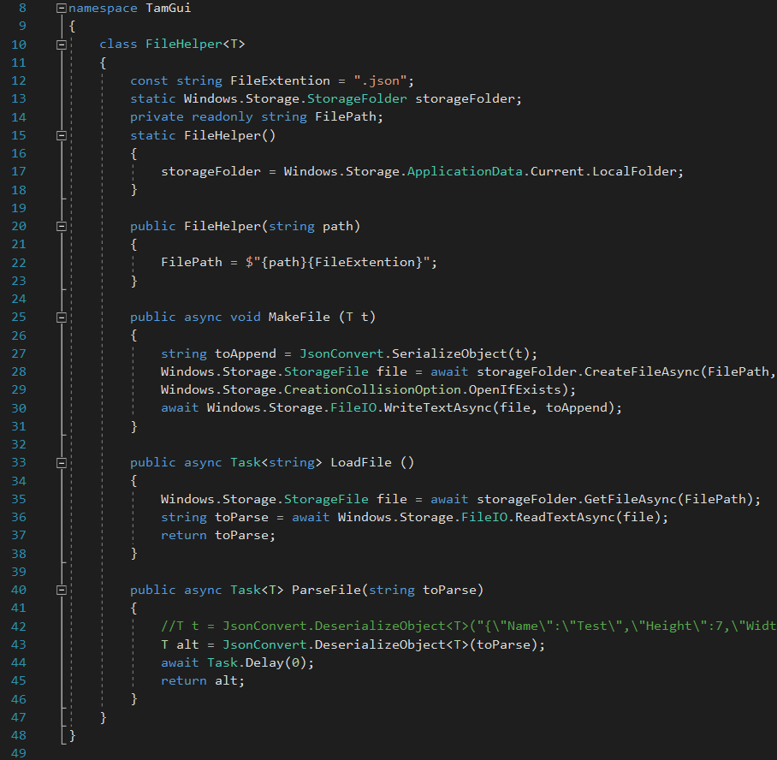
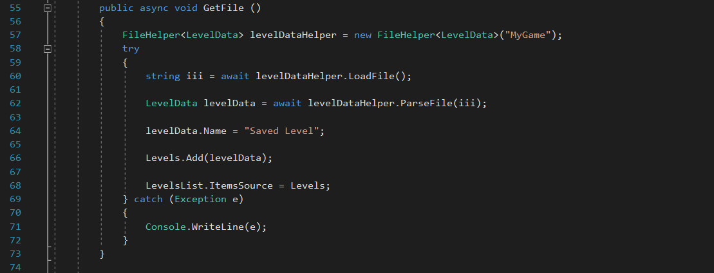
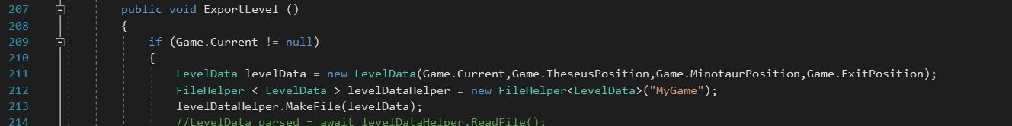
Load and continue to play previous unfinished game by using file storage to save and load a status of the game during playing
Example string for testing
Commented out code is unused
Uses async
Uses Newtonsoft JSON library

Slide 28

Play Relevant Sounds or videos

Slide 29

Play Relevant Sounds or videos

Slide 30
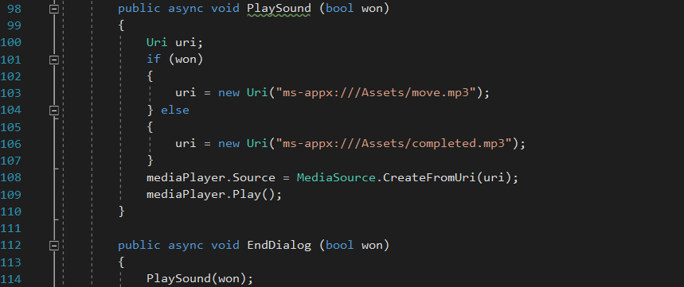
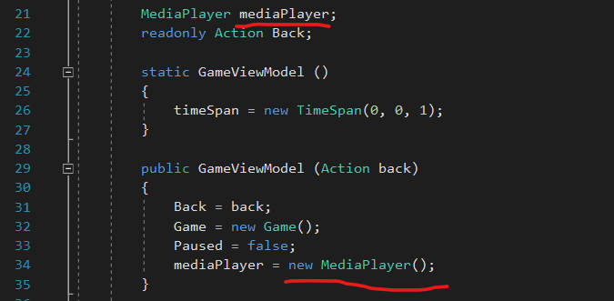
Play Relevant Sounds or videos
Unique sounds for winning and losing games
Sounds play when game won or lost

Slide 31
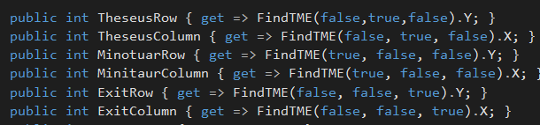
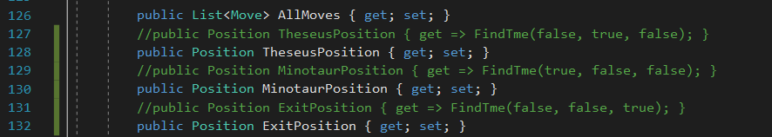
Refactoring Model Code – Properties
Original Version
New Version

Slide 32
Refactoring Model Code – Properties
From 6 lines to 3 lines(3 line reduction total)
Position.x and Position.y allow for accessing the x and y values
Commented lines are old code left for safety when making changes

Slide 33
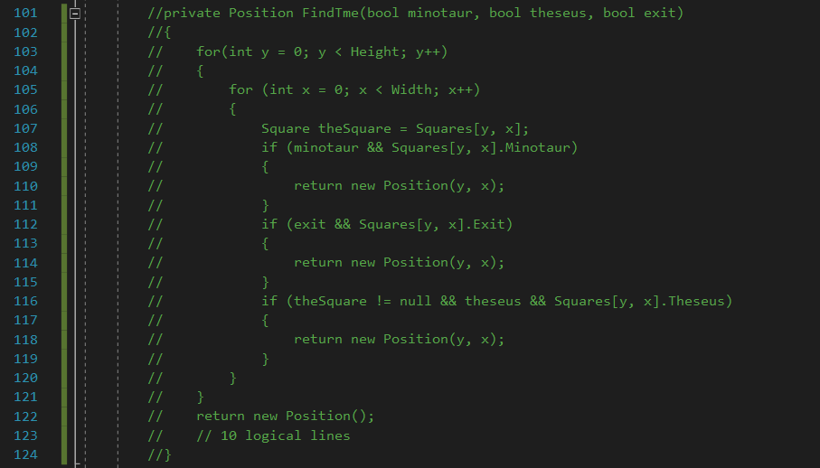
Replace FindTME and Dicts
Entire Method removed
FindTME was a overly complex way to handle movement and positions
Instead of the movement methods saving a new position, this method was called by the properties
Removed 10 lines

Slide 34
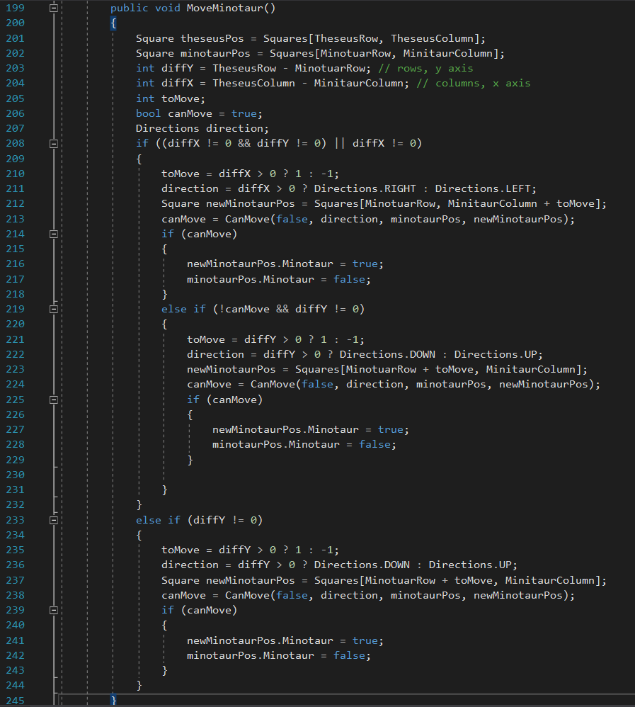
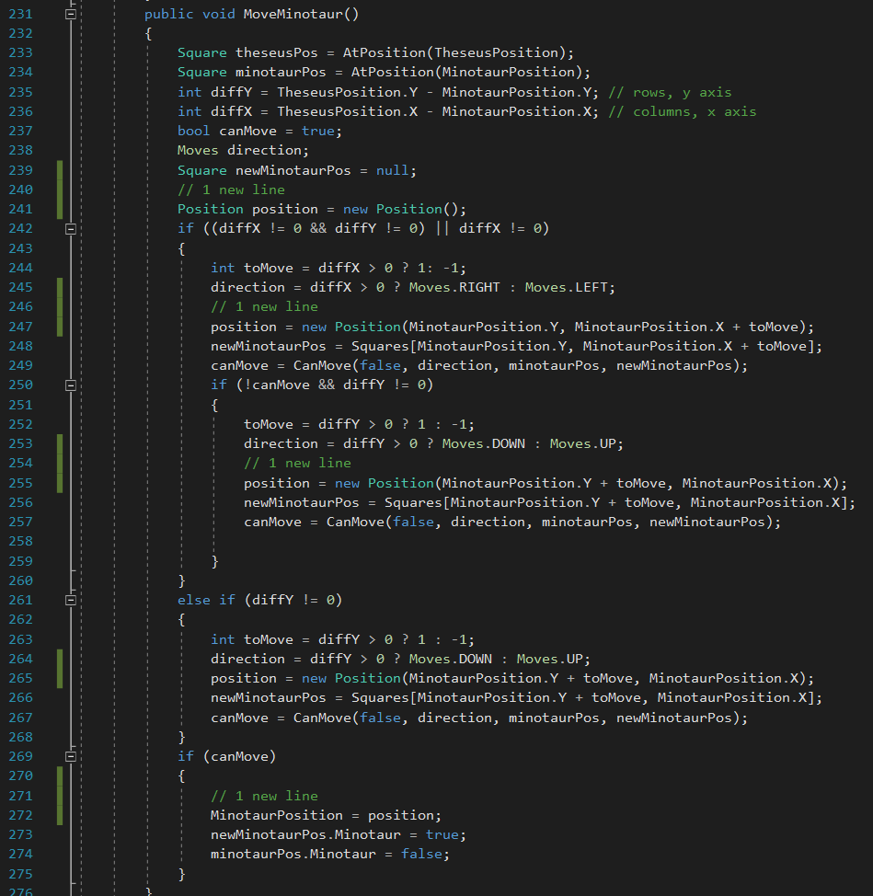
Replace FindTME and Dicts
Original Version
New Version
Same length as original version but with changes made (both 45 lines)
Duplicate code removed
Minotaur movement implemented
Now updates Minotaur Position
Likely could be further improved by removing all duplicate code

Slide 35
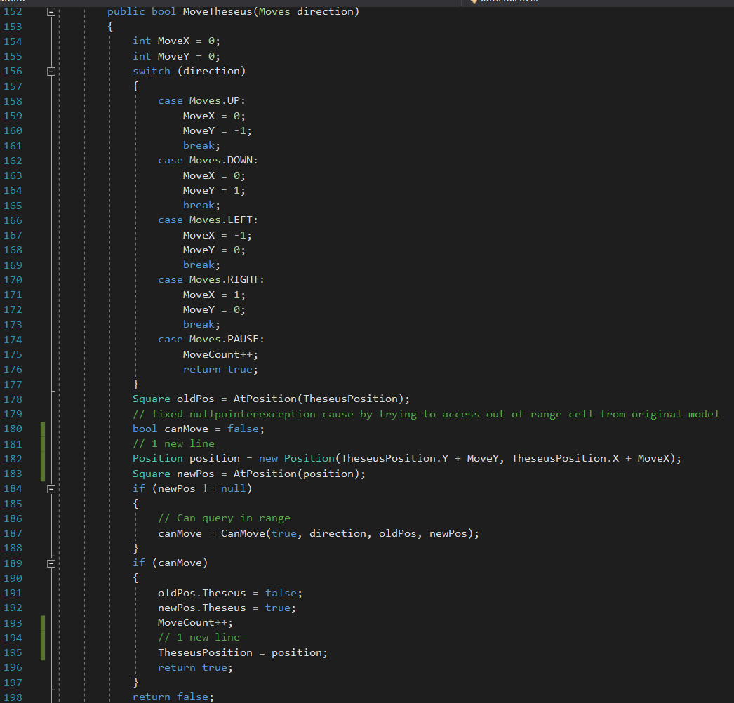
Replace FindTME and Dicts
2 new lines as part of re-implementing theseus position (both commented)

Slide 36
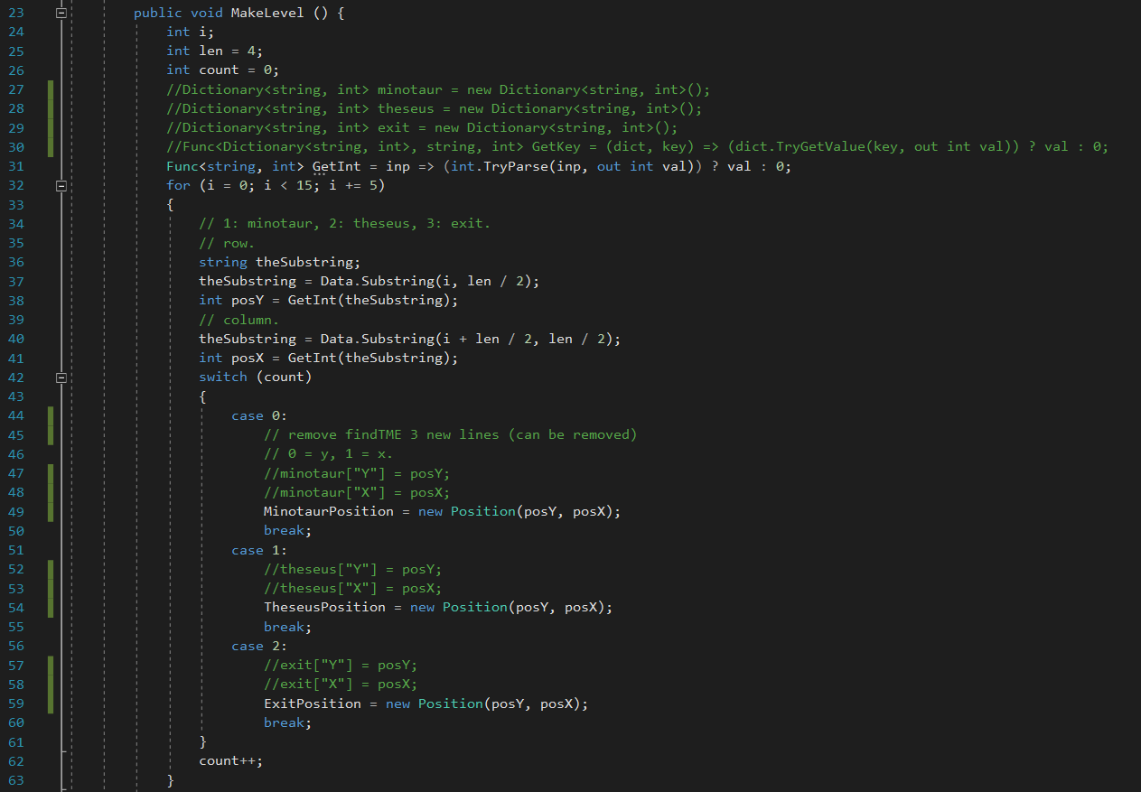
Replace FindTME and Dicts
Dicts replaced with position objects (old code in comments)
7 less lines of code

Slide 37
Refactoring - Expected marks
Removed 10 from FindTME
Removed 7 from MakeLevel
Removed 3 from Level Properties
Added 2 lines to MoveMinotaur
Net lines reduced – 18
Total Marks Expected – 3 marks

